Slide 1




Project On
“LAPTOP PRICE PREDICTION”
A
Presented By:- Group No: 1
Pooja Anil Rathod (210541283020)
Deeksha Deepak Ingle (210541283037) Under Guidance Of
Mr. Akshay Tilekar
e- DBDA May 2021
Institute for Advance Computing and Software Development Akurdi, Pune. 411044

Slide 2
Contents
Introduction
Objectives
Block Diagram
Working Methodology
Experimental Analysis
Significance
Future Scope
Conclusion

Slide 3
Introduction
Price is the most effective attribute of marketing and business. The very first question of costumer is about the price of items. All the costumers are first worried and thinks “If he would be able to purchase something with given specifications or not”. Artificial Intelligence-which makes machine capable to answer the questions intelligently now-a-days is very vast engineering field. Machine learning provides us best techniques for artificial intelligence like classification, regression, supervised learning and unsupervised learning and many more. Different tools are available for machine learning tasks like MATLAB, Python, Cygwin, WEKA etc. We can use any of classifiers like, Linear Regression, KNN and many more. Different type of feature selection algorithms are available to select only best features and minimize dataset. This will reduce computational complexity of the problem. As this is optimization problem so many optimization techniques are also used to reduce dimensionality of the dataset Laptop now a days is one of the most selling and purchasing device. Every day new Laptops with new version and more features are launched. Hundreds and thousands of mobile are sold and purchased on daily basis. So here the mobile price class prediction is a case study for the given type of problem i.e. finding optimal product.

Slide 4
Objectives
Cost prediction is the very important factor of marketing and business. To predict the cost same procedure can be performed for all types of products for example Cars, Foods, Medicine, Laptops etc.
Best marketing strategy is to find optimal product (with minimum cost and maximum specifications). So products can be compared in terms of their specifications, cost, manufacturing company etc.
By specifying economic range a good product can be suggested to a costumer.

Slide 5
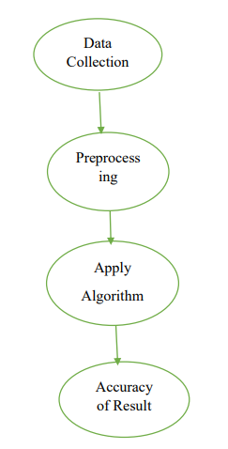
Block Diagram

Slide 6
Working Method

Slide 7
Functions Used
 | mean : Mean value.
 | std : Standard deviation.
 | mad : Median absolute value.
 | max: Largest values in array.
 | min: Smallest value in array.
 | sma: Signal magnitude area.
 | Energy: Average sum of the squares
 | iqr : Interquartile range.
 | entropy: Signal Entropy.
 | correlation : Correlation coefficient.

Slide 8
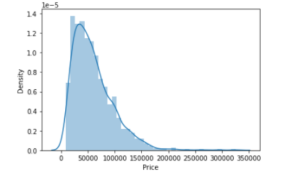
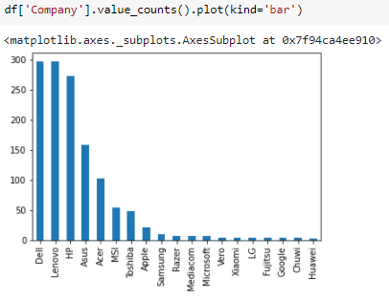
Data Visualization

Slide 9
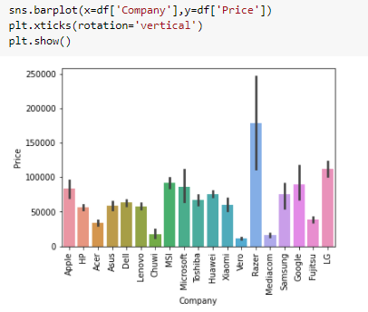
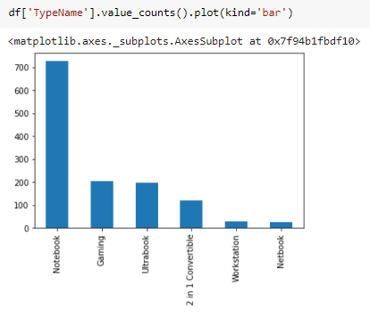

Slide 10
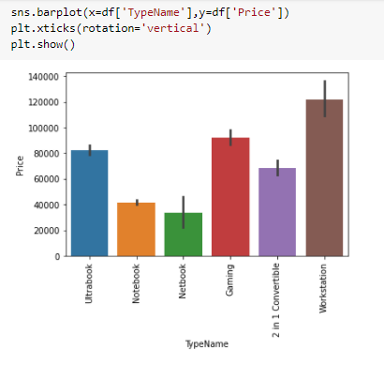
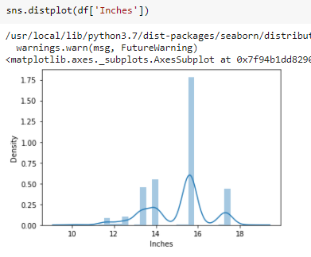

Slide 11
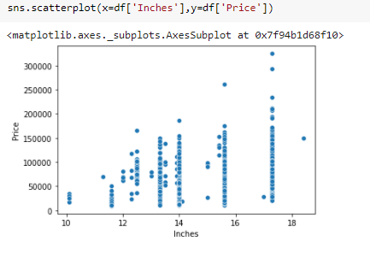
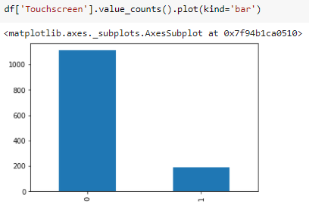

Slide 12
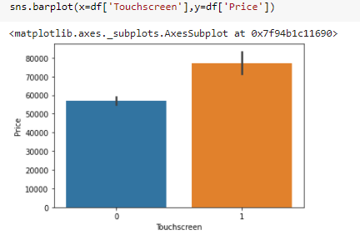
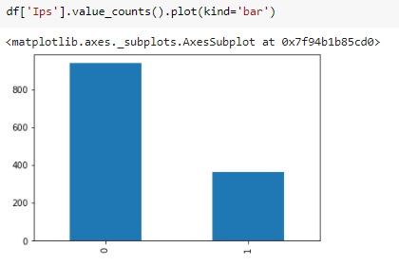

Slide 13
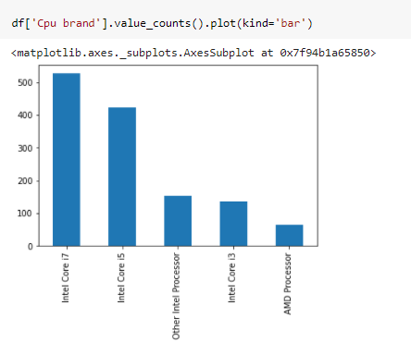
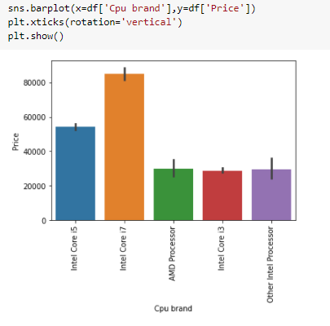

Slide 14
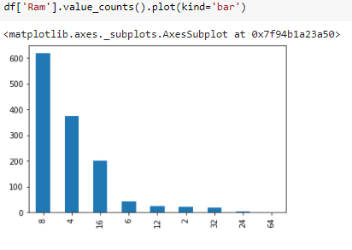
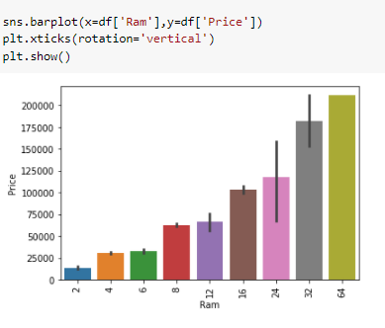

Slide 15
Experimental Analysis
In this project we have used following machine learning
algorithms for model building and prediction of results.
Random Forest
K-Nearest Neighbours (KNN)
Adaboost
Gradient Boost
Decision Trees
XG Boost
Based on above algorithms, we have predicted results by building model and visualized in proper manner to get best accuracy.

Slide 16
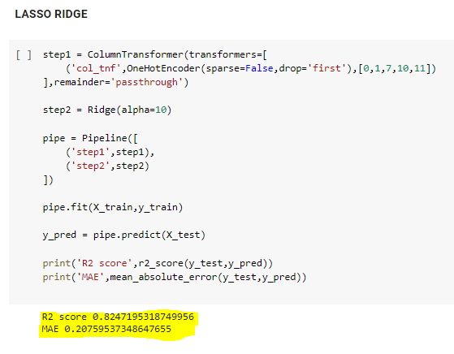
Lasso and Ridge

Slide 17
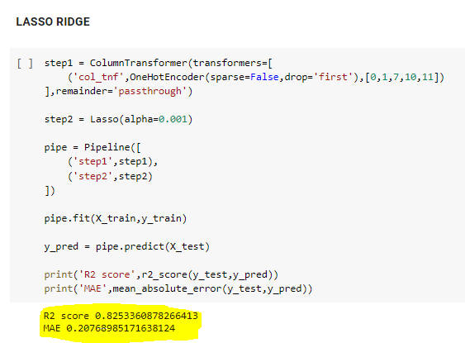
Lasso and Ridge

Slide 18
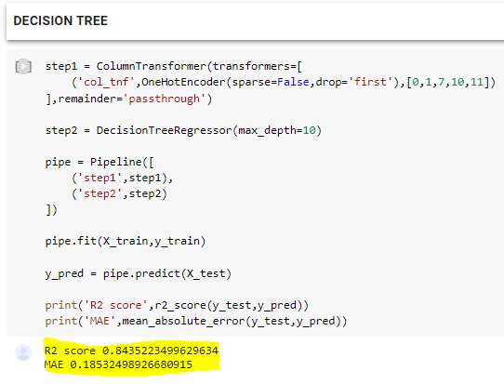
Decision Tree:

Slide 19
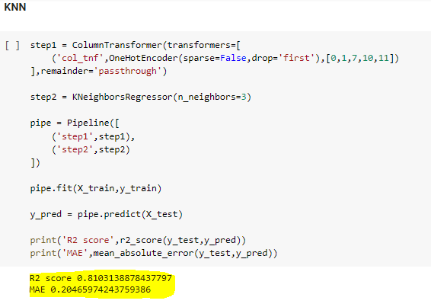
KNN:

Slide 20
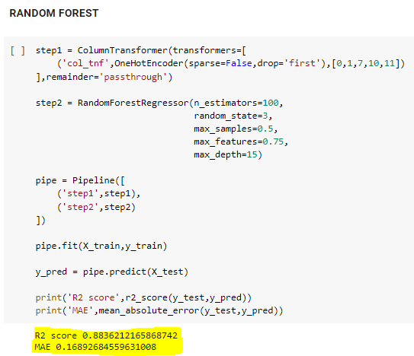
Random Forest:

Slide 21
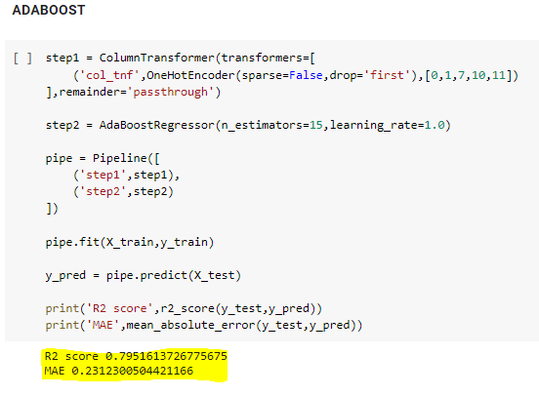
ADABoost:

Slide 22
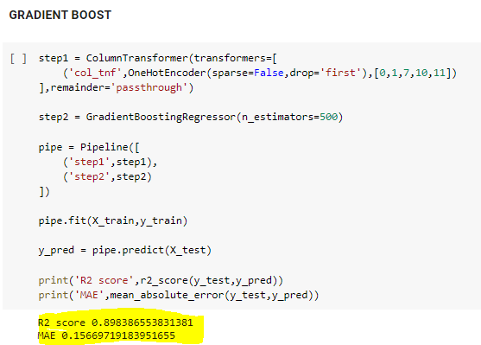
GRADIENT BOOST:

Slide 23
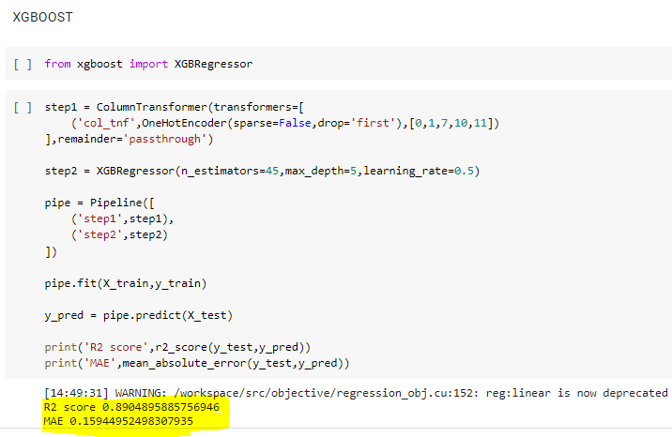
XGBOOST:

Slide 24
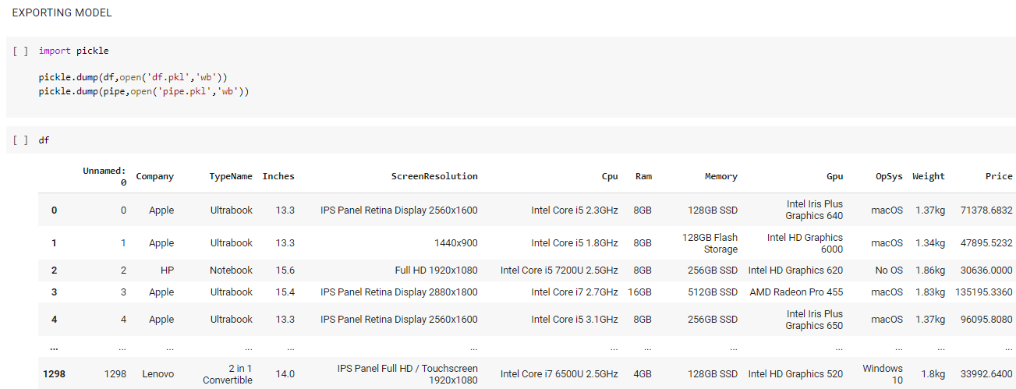
Exported Final Model:

Slide 25
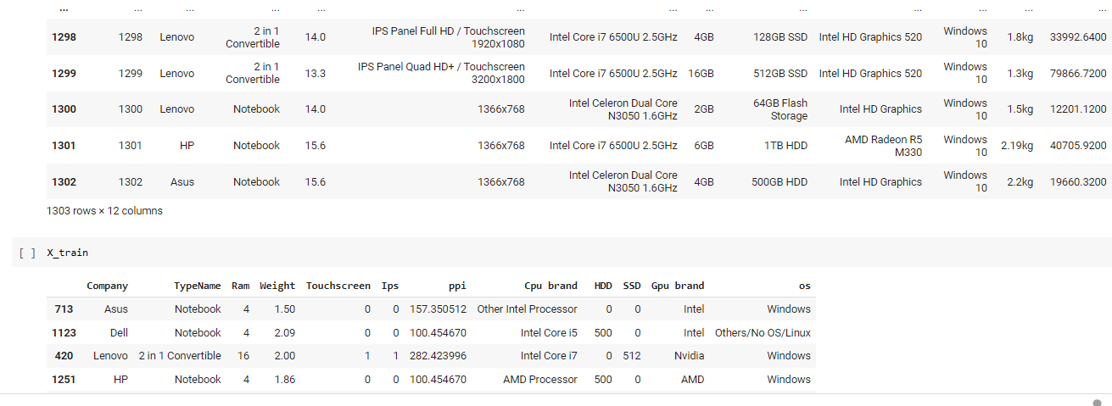
Exporting Model:

Slide 26
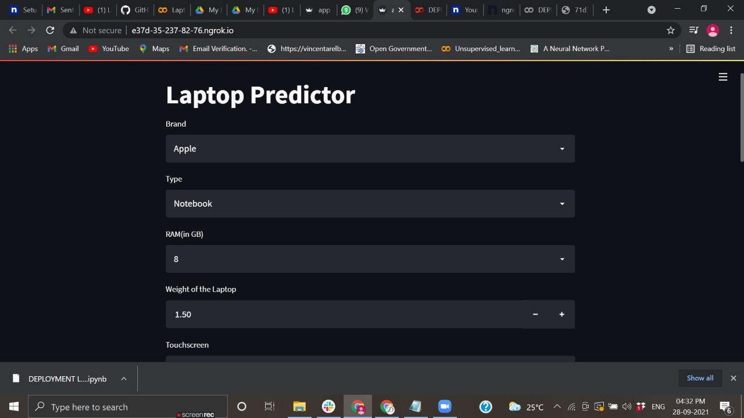
Final Result:

Slide 27
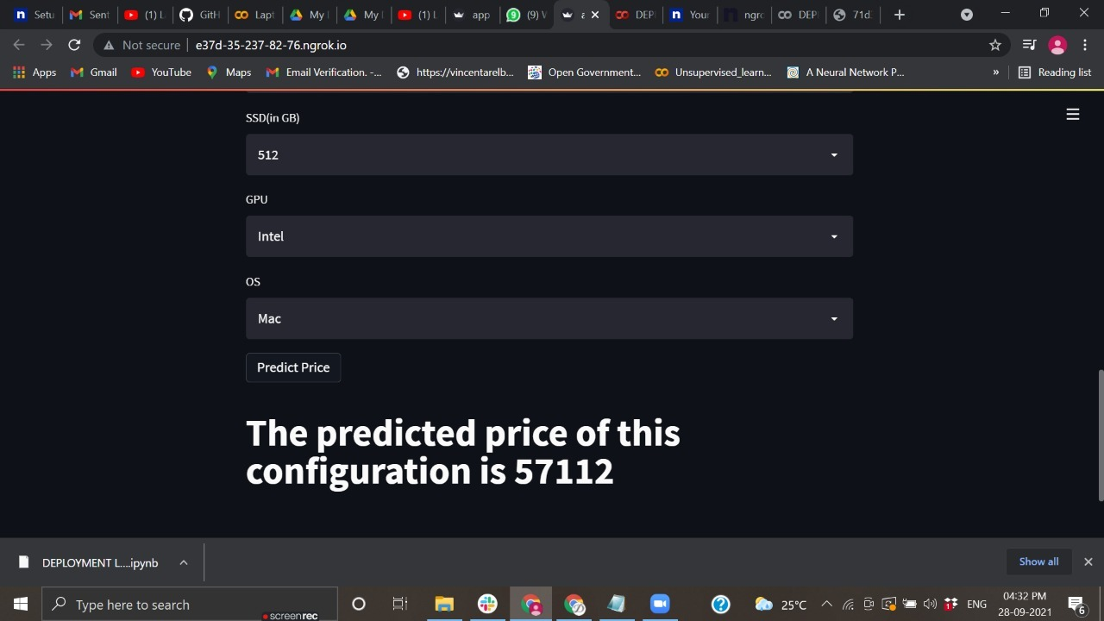

Slide 28
Future Scope
More sophisticated artificial intelligence techniques can be used to maximized the accuracy and predict the accurate price of the products. Software or Mobile app can be developed that will predict the market price of any new launched product. To achieve maximum accuracy and predict more accurate, more and more instances should be added to the data set. And selecting more appropriate features can also increase the accuracy. So data set should be large and more appropriate features should be selected to achieve higher accuracy.

Slide 29
Conclusion
This work can be concluded with the comparable results of both Feature selection algorithms and classifier. This combination has achieved maximum accuracy and selected minimum but most appropriate features. It is important to note that in Forward selection by adding irrelevant or redundant features to the data set decreases the efficiency of both classifiers. While in backward selection if we remove any important feature from the data set, its efficiency decreases. The main reason of low accuracy rate is low number of instances in the data set. One more thing should also be considered while working that converting a regression problem into classification problem introduces more error

Slide 30
Thank You

